Slide 1
Constructor
Constructors are functions of a class that are executed when new objects of the class are created.
The constructors have the same name as the class and no return type, not even void.
They are primarily useful for providing initial values for variables of the class.

Slide 2
Characteristics of Constructors
These are called automatically when the objects are created.
All objects of the class having a constructor are initialized before some use.
These should be declared in the public section for availability to all the functions.
Return type (not even void) cannot be specified for constructors.
These cannot be inherited, but a derived class can call the base class constructor.
These cannot be static.
Default and copy constructors are generated by the compiler wherever required.
Generated constructors are public.
These can have default arguments as other C++ functions.
A constructor can call member functions of its class.
An object of a class with a constructor cannot be used as a member of a union.
A constructor can call member functions of its class.
We can use a constructor to create new objects of its class and constructors cannot be virtual.

Slide 3
Types of Constructor
Default Constructor
Parameterized Constructor
Copy Constructor

Slide 4
Default constructor
Default constructor do not take any parameters.
If a default constructor is not provided by the programmer explicitly, then the compiler provides a implicit default constructor.
In that case, the default values of the variables are 0.

Slide 5
Demonstration of default constructor
#include <iostream>
using namespace std;
class A {
private:
int num1, num2 ;
public:
A() {
num1 = 5; num2 = 7;
}
void display() {
cout<<"num1 = "<< num1 <<endl; cout<<"num2 = "<< num2 <<endl;
} };
int main() {
A obj;
obj.display();
return 0;
}

Slide 6
Parameterized Constructor
The parameterized constructor can take arguments to initialize an object when it is created.
Parameters are added to a parameterized constructor just like they are added to a normal function.
The parameterized constructors can be called implicitly or explicitly.

Slide 7
Demonstration of parameterized constructor
#include <iostream>
using namespace std;
class A {
private:
int num1, num2 ;
public:
A(int n1, int n2) {
num1 = n1;
num2 = n2;
}
void display() {
cout<<"num1 = "<< num1 <<endl; cout<<"num2 = "<< num2 <<endl;
} };
int main() {
A obj(3,8);
obj.display();
return 0;
}

Slide 8
Copy Constructor
A copy constructor is a member function that initializes an object using another object of the same class.
A copy constructor has the following general function prototype:
ClassName (ClassName &old_obj);
Copy constructor is used to initialize the members of a newly created object by copying the members of an already existing object.
Copy constructor takes a reference to an object of the same class as an argument.
Sample(Sample &t)
{
id=t.id;
}
The copy constructor can be defined explicitly by the programmer. If the programmer does not define the copy constructor, the compiler does it for us.

Slide 9
Demonstration of copy constructor
class Point {
private:
int x, y;
public:
Point(int x1, int y1)
{
x = x1;
y = y1;
}
// Copy constructor
Point(const Point& p1)
{
x = p1.x;
y = p1.y;
}
int getX() { return x; }
int getY() { return y; }
};
int main()
{
Point p1(10, 15); // Normal constructor is called here
Point p2 = p1; // Copy constructor is called here
// Let us access values assigned by constructors
cout << "p1.x = " << p1.getX()
<< ", p1.y = " << p1.getY();
cout << "\np2.x = " << p2.getX()
<< ", p2.y = " << p2.getY();
return 0;}

Slide 10
Demonstration of copy constructor
#include <iostream>
using namespace std;
class A
{
public:
int x;
A(int a) // parameterized constructor.
{
x=a;
}
A(A &i) // copy constructor
{
x = i.x;
}
};
int main()
{
A a1(20); // Calling the parameterized constructor.
A a2(a1); // Calling the copy constructor.
cout<<a2.x;
return 0; }

Slide 11
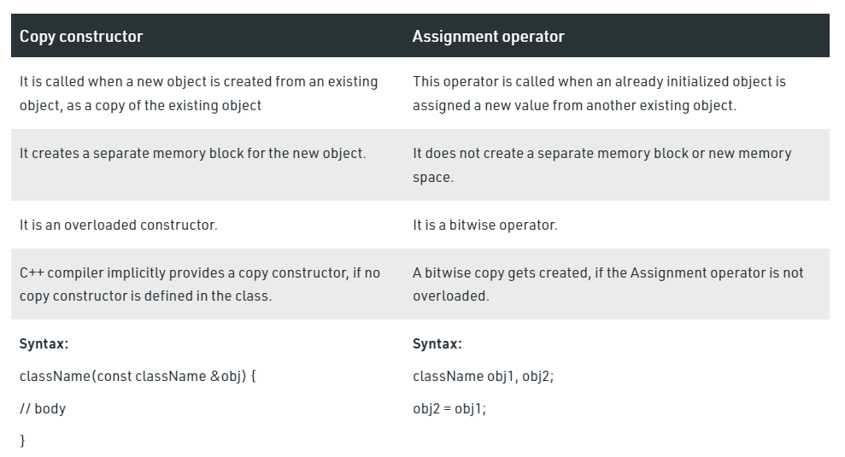
Difference between Copy Constructor and Assignment Operator

Slide 12
Implicit and Explicit calling of Constructor
Implicit constructor is that which is provided by default in a class and explicit constructor is that which we specify explicitly in our class.
If we provide constructor explicitly then there is no implicit constructor provided by the compiler and if there is no explicit constructor then compiler will provide implicit constructor.

Slide 13
Example
Class Sample
{
Sample(int)
{…..}
};
int main(){
Sample s = sample (20); //Explicit constructor
Sample s(20); //Implicit constructor
Return 0
}

Slide 14
Destructor
A destructor is a special member function of a class that is executed whenever an object of it's class goes out of scope or whenever the delete expression is applied to a pointer to the object of that class.
A destructor will have exact same name as the class prefixed with a tilde (~) and it can neither return a value nor can it take any parameters. Destructor can be very useful for releasing resources before coming out of the program like closing files, releasing memories etc.

Slide 15
Example
#include <iostream>
using namespace std;
class Line {
public:
void setLength( double len );
double getLength( void );
Line(); // This is the constructor declaration
~Line(); // This is the destructor: declaration
private: double length; };
// Member functions definitions including constructor
Line::Line(void) {
cout << "Object is being created" << endl;
}
Line::~Line(void) {
cout << "Object is being deleted" << endl;
}
void Line::setLength( double len ) {
length = len;
}
double Line::getLength( void )
{
return length;
}
// Main function for the program
int main() {
Line line;
// set line length
line.setLength(6.0);
cout << "Length of line : " << line.getLength() <<endl;
return 0; }

